Slide 1
Tópicos avançados em FHIR II
Italo Macêdo
italo@gointerop.com

Slide 2
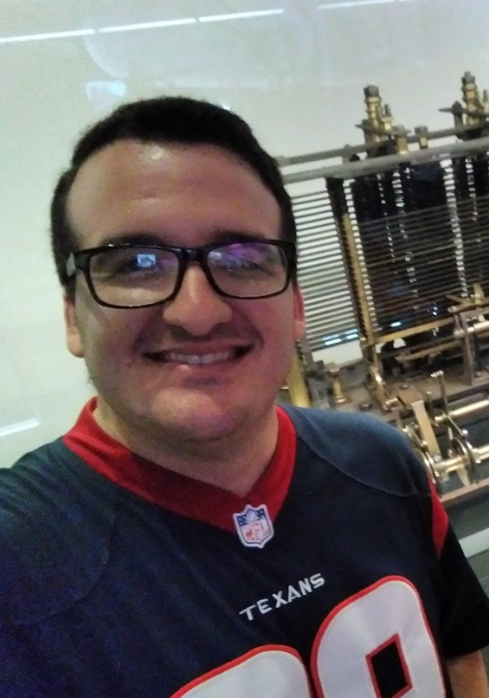
Quem sou eu
Arquiteto de Interoperabilidade.
Coordenador técnico do HL7 Brasil.
Tutor do HL7 Brasil.

Slide 3
CDS Hooks
Clinical Decision Support System (CDSS);
Apoio à decisão clínica;
Hook (ou Gancho);
Eventos entre componentes de aplicativos (ou sistemas) que disparam mudanças de estado ou efeito nessa aplicação;
In computer programming, the term hooking covers a range of techniques used to alter or augment the behaviour of an operating system, of applications, or of other software components by intercepting function calls or messages or events passed between software components. Code that handles such intercepted function calls, events or messages is called a hook.
https://en.wikipedia.org/wiki/Hooking

Slide 4
CDS Hooks
Componentes
CDS Service A decision support service that accepts requests containing patient information, and provides responses;
CDS Client or EHR An electronic health record, or other clinical information system that consumes decision support in the form of services MAY provide an authorization and FHIR resource server;
Hook A defined point within the client system's workflow with well-known contextual information provided as part of the request;
Card Guidance from decision support services is returned in the form of cards representing discrete recommendations or suggestions that are presented to the user within the CDS Client.

Slide 5

1
CDS
Services
2
EHR Med Order
CPOE triggers a CDS hook and invokes a remote service
Toprol XL 50 mg daily
CDS Service executes its own rules, leveraging FHIR data as needed
℞
information card
$200 per month (patient pays $30)
EHR
FHIR Server
3
suggestion card
Returns CDS cards
(rendered and displayed by CPOE)
Try Propranolol instead
Switch to Propranolol
smart app link card
Managing hypertension? Launch JNC 8 Rx Pro

Slide 6


CDS Client
CDS Service
POST https://example.com/cds-services/example-service
{
"hook": "patient-view”,
"fhirServer": "https://fhir.example.com",
"context": {
"user": "Practitioner/789"
"patientId": "123",
"encounterId": "456",
},
...
}

Slide 7
EHR
CDS Service
POST https://example.com/cds-services/example-service
HTTP 1.1/ 200 OK
{
"cards": [
{
"summary": "Example card",
"indicator": "info",
"source": {
"name": "Demo CDS Service”
}}]}

Slide 8
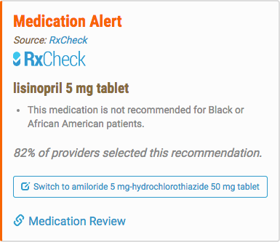
Cards
A CDS Service can return any number of cards
The EHR renders each card as it sees fit
Each card must have:
A concise summary (140 characters)
An indicator noting the importance of the card
Information on the organization or data set that is the source of the card’s data
any combination of information, suggestions, and links

Slide 9
patient-view
Workflow
The patient-view hook fires when
… Isaac to add content.

Slide 10
order-sign
Workflow
The order-sign hook fires when a clinician is ready to sign one or more orders for a patient.
The context contains all order details but has not yet been signed and still exists in a draft status. Use this hook when your service requires all order details, and the clinician will accept recommended changes.
This hook is intended to replace (deprecate) the medication-prescribe and order-review hooks.

Slide 11
encounter-start
Workflow
The encounter-start hook fires when the user is initiating a new encounter, at admission or patient check-in. This hook fires multiple times for the same encounter as each user becomes engaged such that cards are available when decisions are being made about what actions are going to occur during this encounter.
Notably, this hook is used by the Da Vinci Coverage Requirements Discovery IG.

Slide 12
encounter-discharge
Workflow
The encounter-discharge hook fires when the user performing the discharge process, typically for an inpatient encounter.
This hook enables services to provide guidance if the discharge is appropriate, to verify discharge medications, to check for continuity of care planning, to ensure necessary documentation is present for discharge processing, etc.
Notably, this hook is used by the Da Vinci Coverage Requirements Discovery IG.

Slide 13
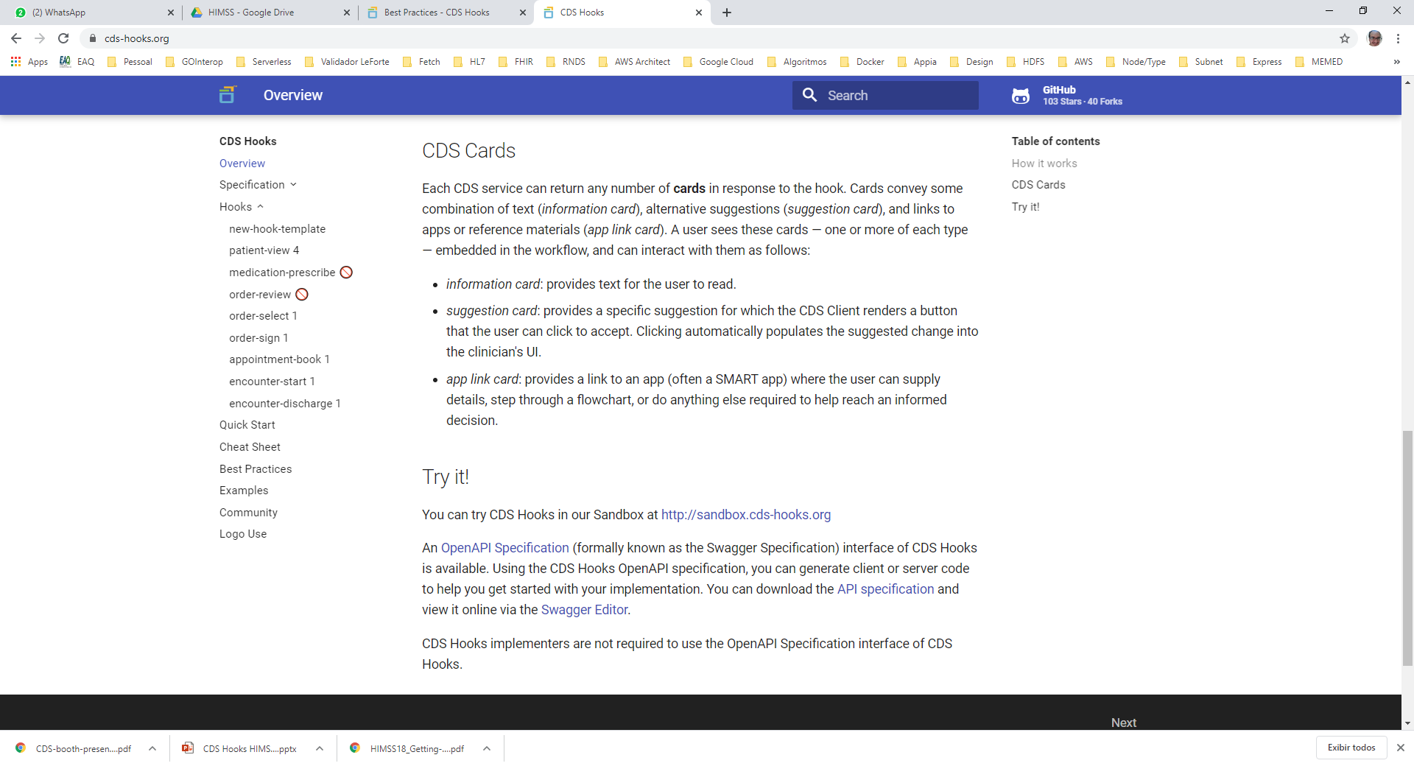
Catálogo de hooks

Slide 14


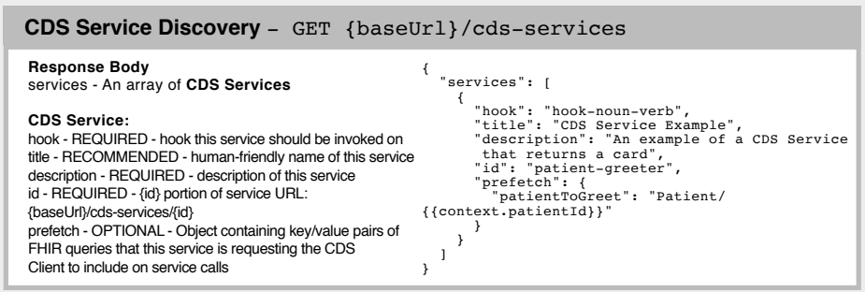
CDS Hooks discovery

Slide 15
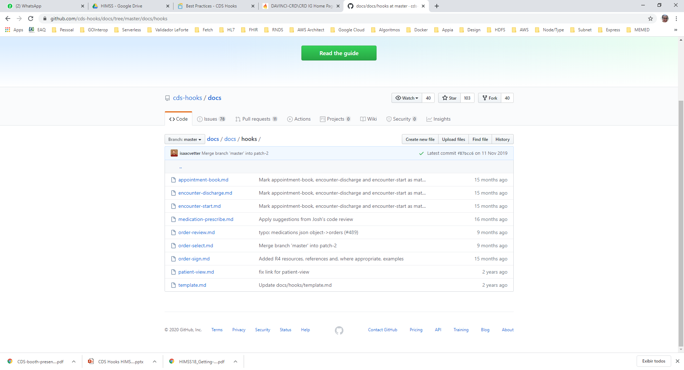
Documentação disponível
https://github.com/cds-hooks/docs/tree/master/docs/hooks

Slide 16
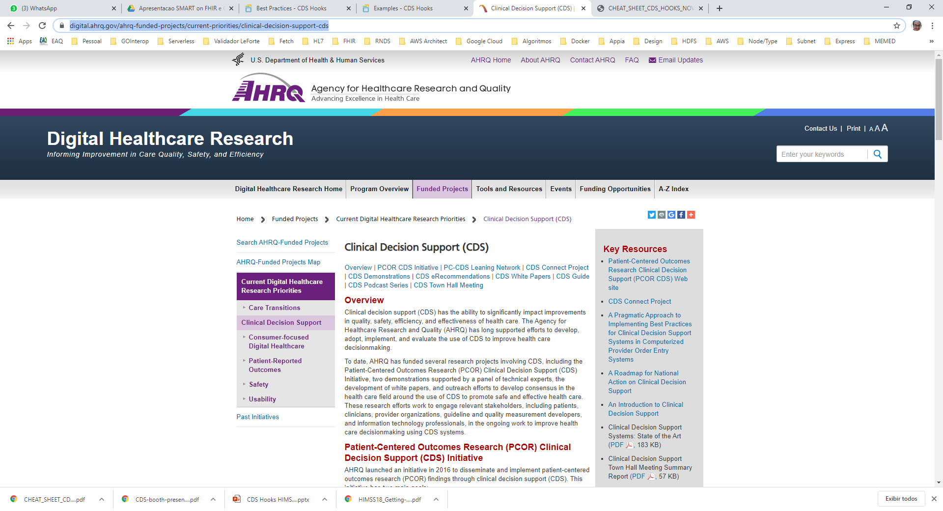
Guia de implementação
CDC Guideline

Slide 17
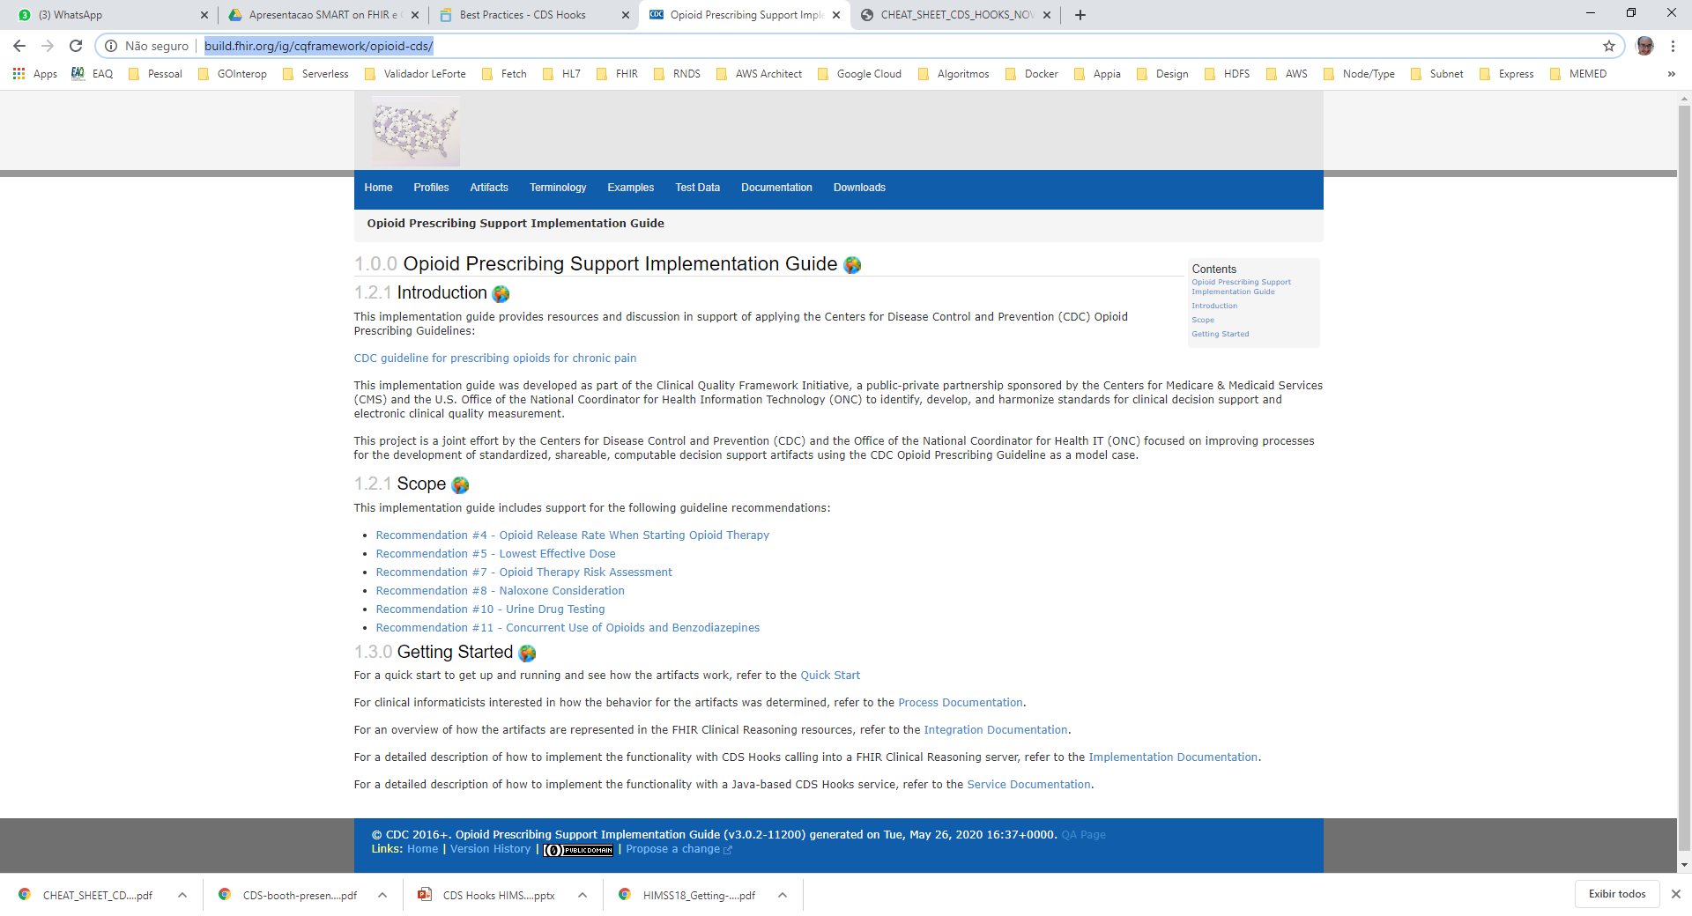
Guia de implementação
http://build.fhir.org/ig/cqframework/opioid-cds/

Slide 18
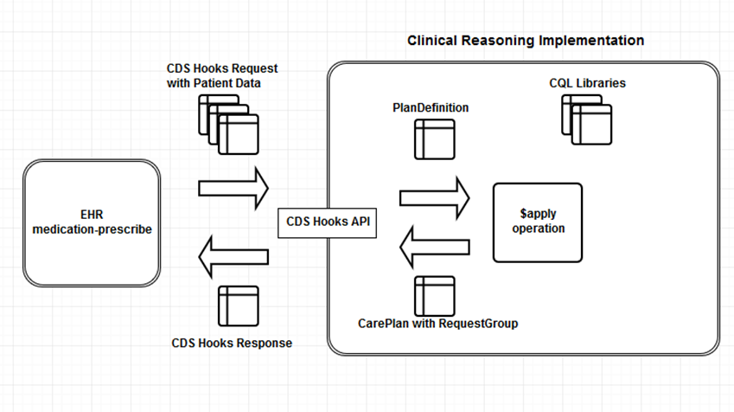
Clinical Quality Framework

Slide 19
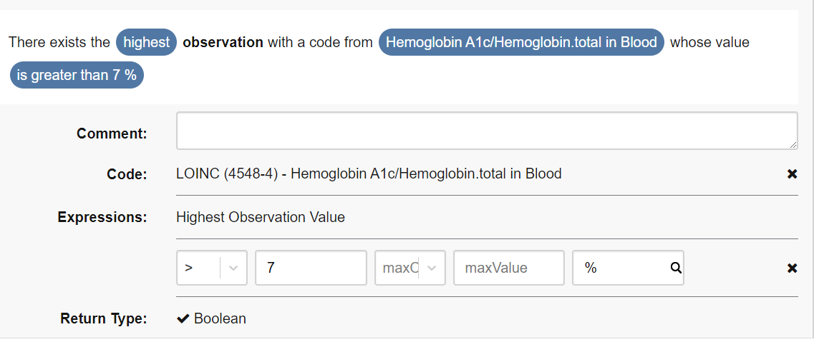
Biblioteca CQL
CQL
Clinical Quality Language
DSL para Qualidade Clínica.
São confrontados com os dado FHIR de um Prefetch da chamada de um CDS Hook.

Slide 20
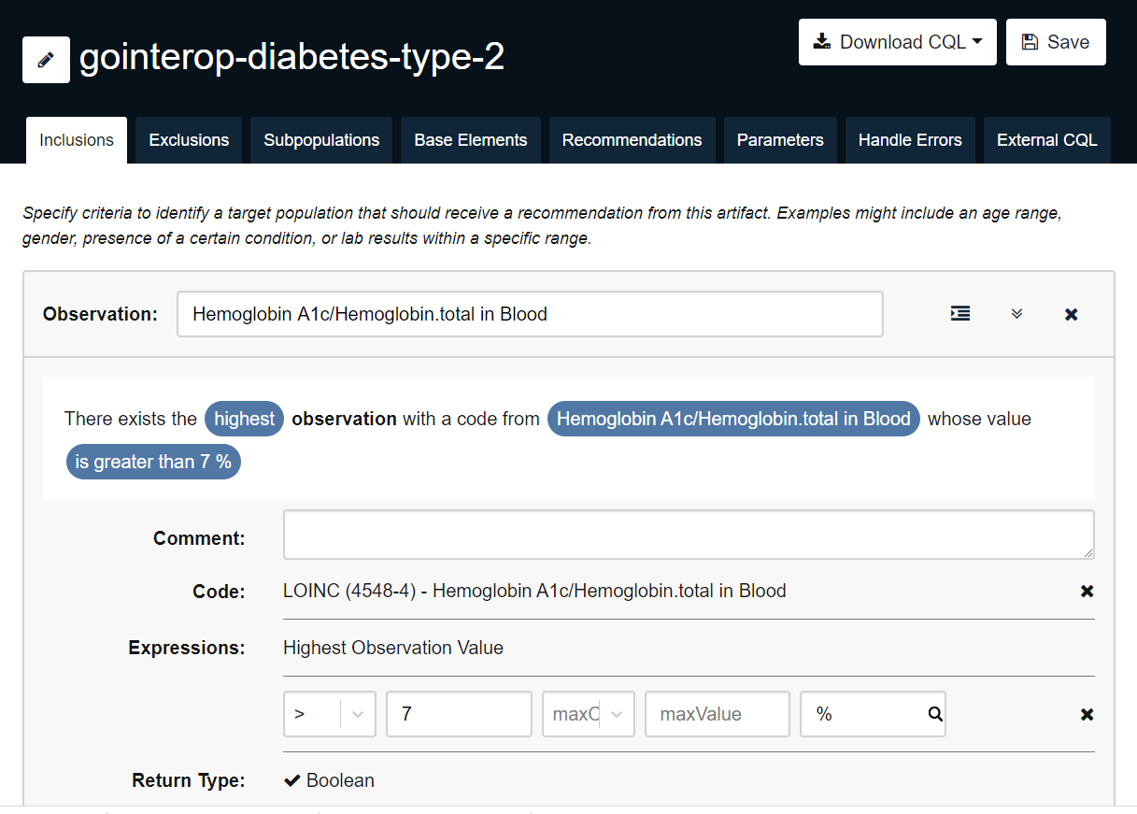
Ferramenta de autoria - UMLS

Slide 21
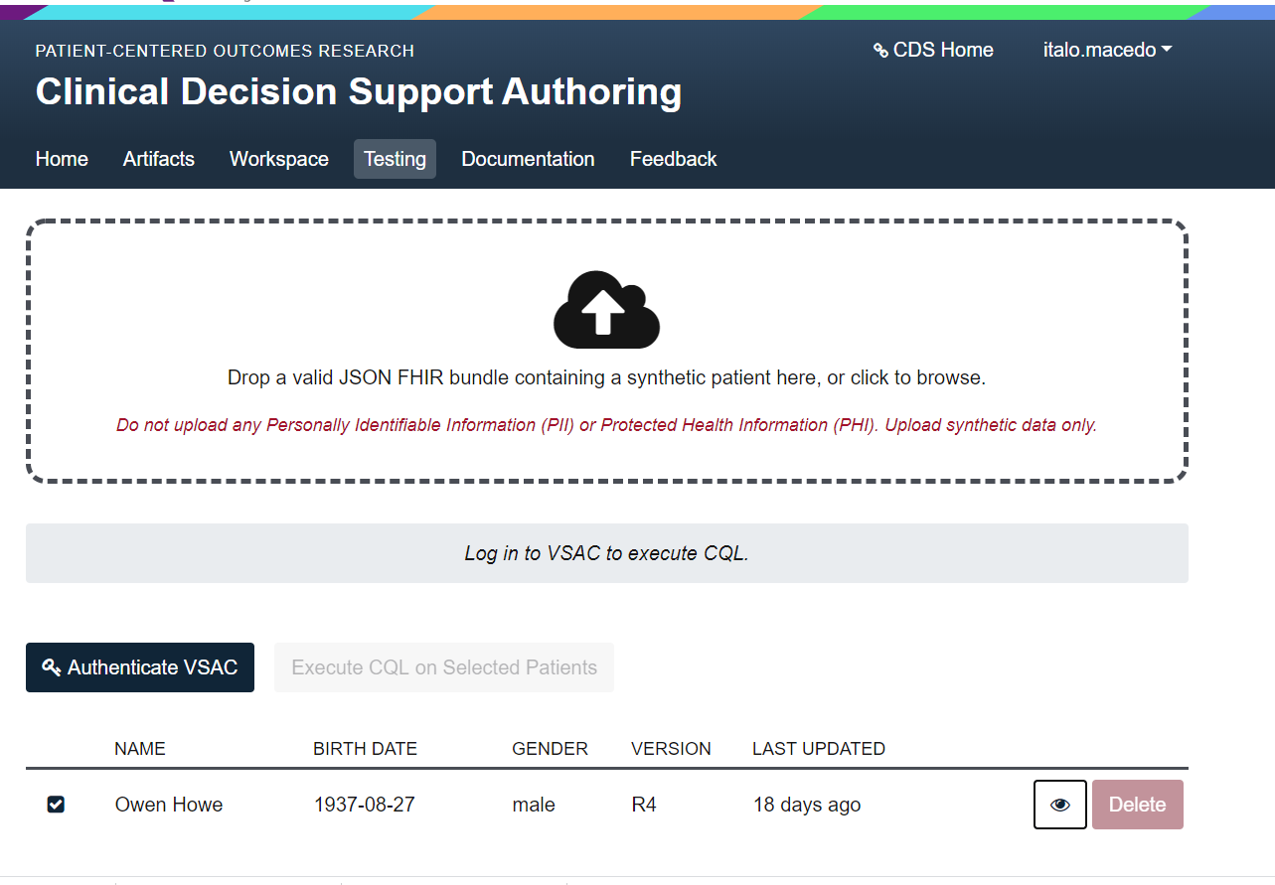

Slide 22



CDS Hooks 1.1 Roadmap
CDS Hooks 1.1 Roadmap
Override reasons
clinician can override a card
Feedback service
tell the cds service what happened with its suggestion
(fka: analytics endpoint)
Refinements to CDS Hooks response
suggestion.isRecommended
card.source.topic

Slide 23
1
CDS
Services
2
EHR Med Order
CPOE triggers a CDS hook and invokes a remote service
Toprol XL 50 mg daily
CDS Service executes its own rules, leveraging FHIR data as needed
℞
EHR
FHIR Server
3
suggestion card
Returns CDS cards
(incl. overrideReasons)
Try Propranolol instead
Switch to Propranolol
4
Returns Feedback

Slide 24
Conclusão
CDS Hooks é uma API de apoio à decisão clínica.
Que se inicia em um evento/gatilho/hook da tela.
Chama a API de apoio à decisão com um prefetch que será confrontado com um conjunto de regras especificadas em uma biblioteca Clinical Quality Language (CQL).
Apresentação de cartões em tela prestando apoio à decisão no momento da intervenção.

